Slide 1
Mancala (Kalah)
By: Morgan Blair and Michael Blankenship

Slide 2

About The Game
There are several versions of Mancala. We picked the popularized version named Kalah.
Kalah is a two player game.
Each player has six pits, and each pit starts out with four stones in them.
Each player has a 'store' to their right side of the board.

Slide 3
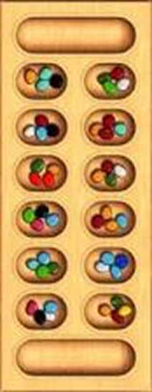
Core of the Game:
A turn is taken when a player picks up all of the stones in any one of the pits on their own side.
The players move the stones around the board according to the rules.
Moving counter-clockwise, the player deposits one of the stones in each hole until the stones run out.

Slide 4
Rules of Kalah:
If you run into your own store, deposit one piece in it. If you run into your opponent's store, skip it.
If the last piece you drop is in your own store, you get a free turn.
If the last piece you drop is in an empty hole on your side, you capture that piece and any pieces in the hole directly opposite and put them in your store.
The game ends when all six pits on a player’s side of the board are empty.
The player who still has pieces on his side of the board when the game ends keeps all of those stones on his side.
Count all the stones in each store. The winner is the player with the most stones.

Slide 5
Our Game:
Player vs Player Mode
Player vs AI Mode
Easy
Medium
Hard
User specifies player names
Includes directions

Slide 6
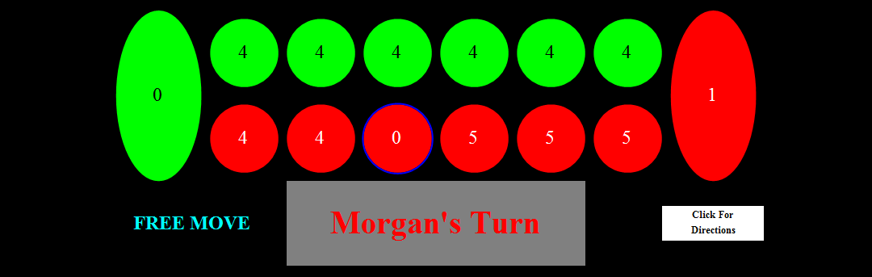
What Our Game Looks Like:
Displays number of stones in each pit
The pit chosen is highlighted blue
Players’ sides are color coded and match player name
Shows whose turn to play
Displays whether a capture or free move has occurred

Slide 7
The Game Mechanic
SampleList = {{4,4,4,4,4,4,0},{4,4,4,4,4,4,0}};
SamplePosition = {2,3};
Show the moveStones function.

Slide 8
AI Strategies:
The Easy AI chooses a random pit on its side.
If the position contains no stones, picks another random pit.
The medium AI implements three different strategic components and operates on a hierarchy to determine which strategy to use.
The first strategy, and the one at the top of the hierarchy is to always take a free move.
The second is always to take a move which captures stones.
The third is to always empty the first pit on your side of the board.
If no pits meet any of the requirements to execute said strategies, the AI will choose a pit to move at random.

Slide 9
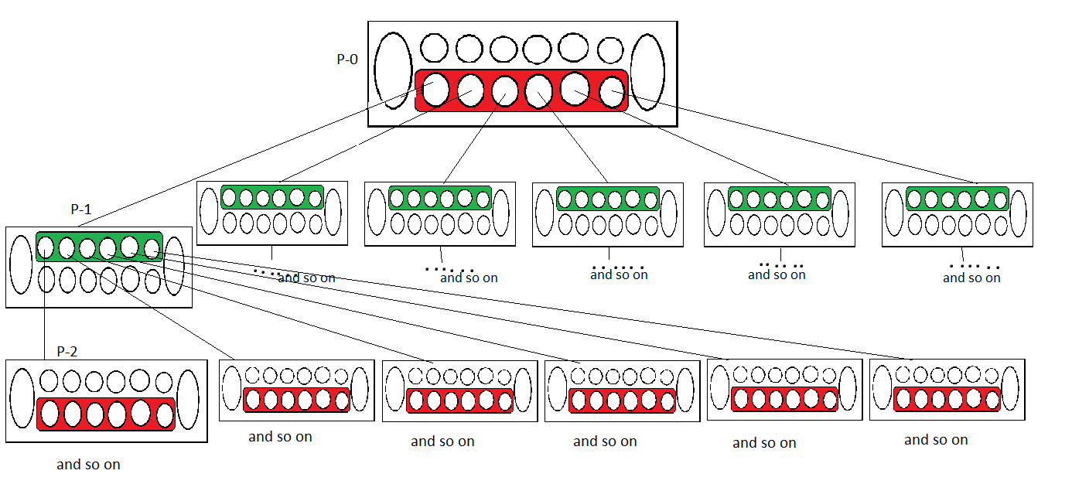
The Hard AI(Generation)
It looks at the current game state.(board)
Generates all available game states from current board.

Slide 10
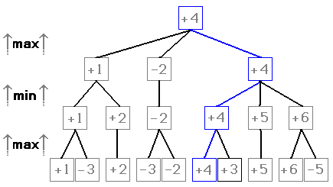
The Hard AI(Evaluation)
Gives bottom game states a value based on a function.
Passes value back up the tree to determine best move.
Takes into account alternating turns.

Slide 11
References(pictures)
Wikipedia(evaluation picture)
http://botton.tripod.com/mancala_eng.htm (mancala board)

